Slide 1
System Design Document (SDD)

Slide 2
Software Design Document “SDD”
The Software Design Document (SDD) is a formal description of the architecture and design of the system
It contains:
  Architecture design
    Modules and their interaction (mostly diagram)

Slide 3
SDD OUTLINE - based on IEEE 1016
  Introduction
    Purpose (SDD)
    Scope (SDD)
    Definitions, Acronyms and Abbreviations
    References
  System Overview
  System Components
    Decomposition Description
    Dependency Description
    Interface Description
      Module Interfaces
      User Interfaces (GUI)
  Detailed Design
    Module Detailed Design
    Data Detailed Design
    RTM

Slide 4
SDD
Introduction
  Introduction
    Purpose (SDD)
    Scope (SDD)
    Definitions, Acronyms and Abbreviations
    References
  System Overview
  System Components
  Detailed Design
    Purpose (SDD)
      Identify the purpose of this SDD and its intended audience. (e.g. “This software design document describes the architecture and system design of XX. ….”).
    Scope (SDD)
      Provide a description and scope of the software and explain the goals, objectives and benefits of your project. This will provide the basis for the brief description of your product.
    Definitions, Acronyms and Abbreviations
    References

Slide 5
Architectural Design
  Common architectural design patterns
    Layered pattern
    Client-server pattern
    Pipe-filter pattern
    Peer-to-peer pattern
    Event-bus pattern
    Model-view-controller pattern
    Blackboard pattern
  …
  Ref: https://towardsdatascience.com/10-common-software-architectural-patterns-in-a-nutshell-a0b47a1e9013

Slide 6
Layered Pattern
This pattern can be used to structure programs that can be decomposed into groups of subtasks, each of which is at a particular level of abstraction.
Each layer provides services to the next higher layer.
  Presentation layer (also known as UI layer)
  Application layer (also known as service layer)
  Business logic layer (also known as domain layer)
  Data access layer (also known as persistence layer)
Usage
  General desktop applications.
  E commerce web applications
FCS - AAO

Slide 7
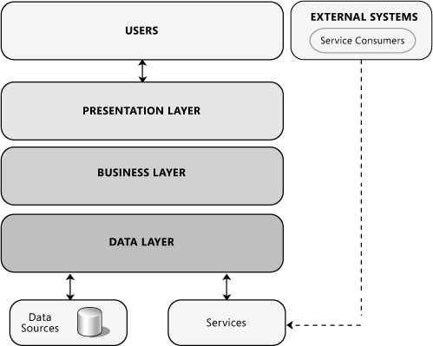

Slide 8
Client-server pattern
This pattern consists of two parties; a server and multiple clients.
The server component will provide services to multiple client components.
Clients request services from the server and the server provides relevant services to those clients.
Furthermore, the server continues to listen to client requests.
Usage: Online applications such as email, document sharing and banking
FCS - AAO

Slide 9
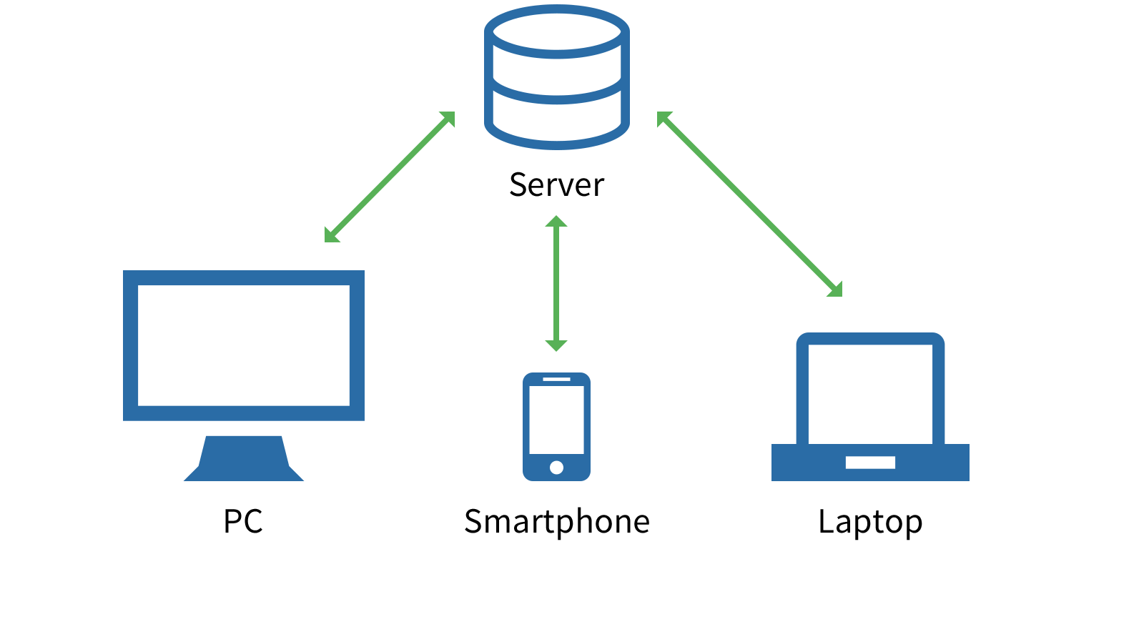

Slide 10
Pipe-filter pattern
This pattern can be used to structure systems which produce and process a stream of data.
Each processing step is enclosed within a filter component.
Data to be processed is passed through pipes.
These pipes can be used for buffering or for synchronization purposes
Usage: Compilers. The consecutive filters perform lexical analysis, parsing, semantic analysis, and code generation.

Slide 11
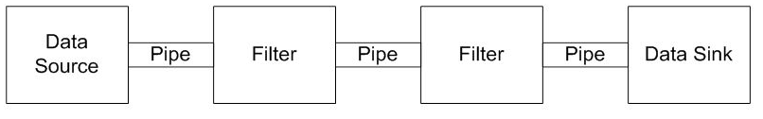
Pipe-filter pattern
Notes:
Organize systems using pipes and filers. Input data originates from data source components, output is compused by data sink compoinents
Each transformation required to conver the input into the ooupt is implemented by a filter component
Data sources, filter and data sinks are arranged in a pipeline.
Piles connect adjacent components, the output of one component becoming the input to the next one

Slide 12
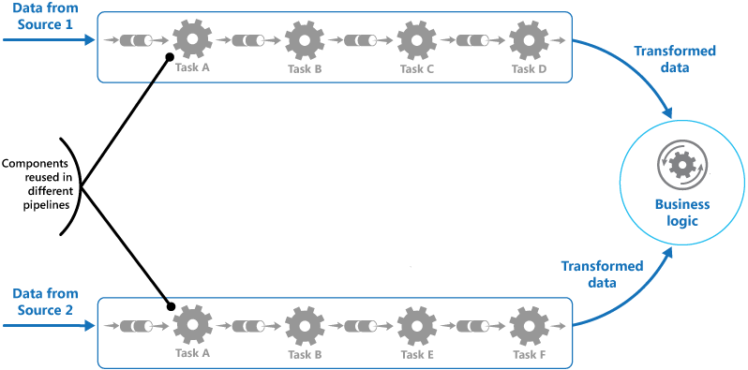

Slide 13
Peer-to-Peer
In this pattern, individual components are known as peers.
Peers may function both as a client, requesting services from other peers, and as a server, providing services to other peers.
A peer may act as a client or as a server or as both, and it can change its role dynamically with time.
Usage
  File-sharing networks
  Multimedia protocols

Slide 14
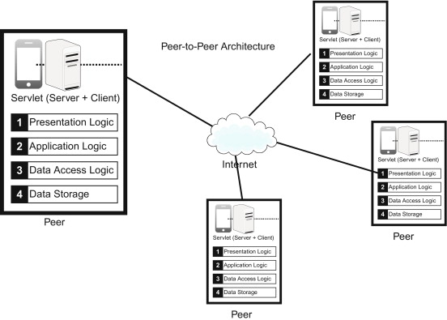

Slide 15
Event-Bus
This pattern primarily deals with events and has 4 major components; event source, event listener, channel and event bus.
Sources publish messages to particular channels on an event bus. Listeners subscribe to particular channels. Listeners are notified of messages that are published to a channel to which they have subscribed before.
Usage
  Android development
  Notification services

Slide 16
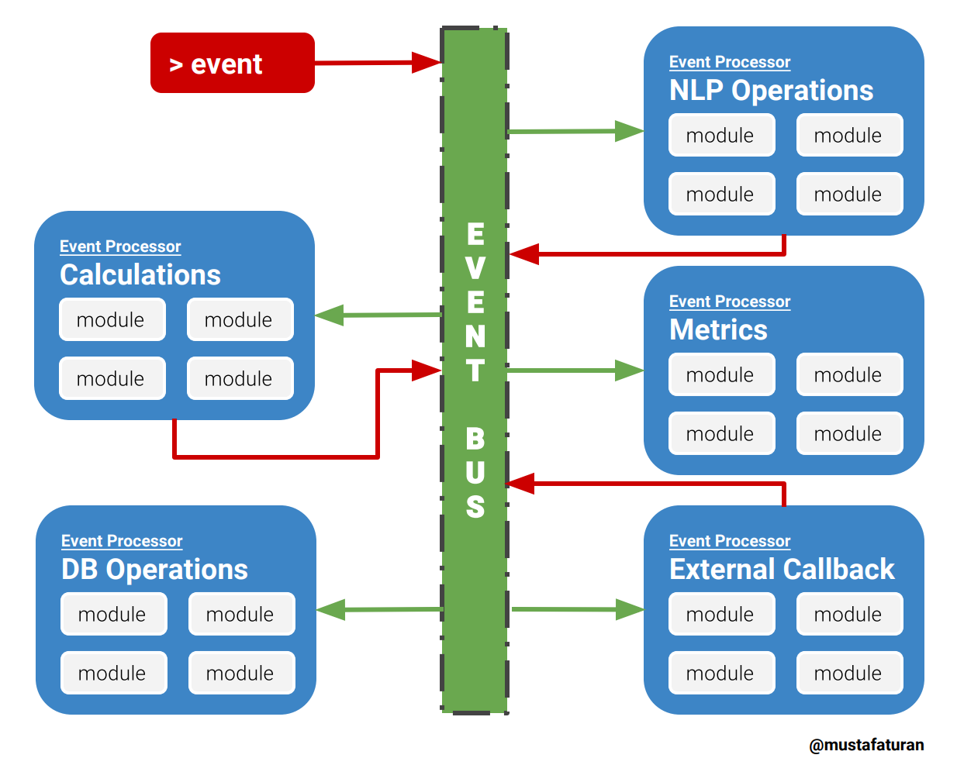
Notes:
Event-driven architecture pattern is a distributed asynchronous architecture pattern to create highly scalable reactive applications. The pattern suits for every level application stack from small to complex ones. The main idea is delivering and processing events asynchronously. Whenever the event bus receives an event from event creators, it passes the event to all subscribers. Subscribers process the event data with their own logic. Subscribers can also create new events and pass it to the event bus too. Event bus does not care about if the receiver fails to receive the event message.
Sources publish messages to particular channels on an event bus. Listeners subscribe to particular channels. Listeners are notified of messages that are published to a channel to which they have subscribed before.

Slide 17
Model-view-controller pattern
model — contains the core functionality and data
view — displays the information to the user (more than one view may be defined)
controller — handles the input from the user
Usage:
  Architecture for World Wide Web applications in major programming languages.
  Web frameworks

Slide 18
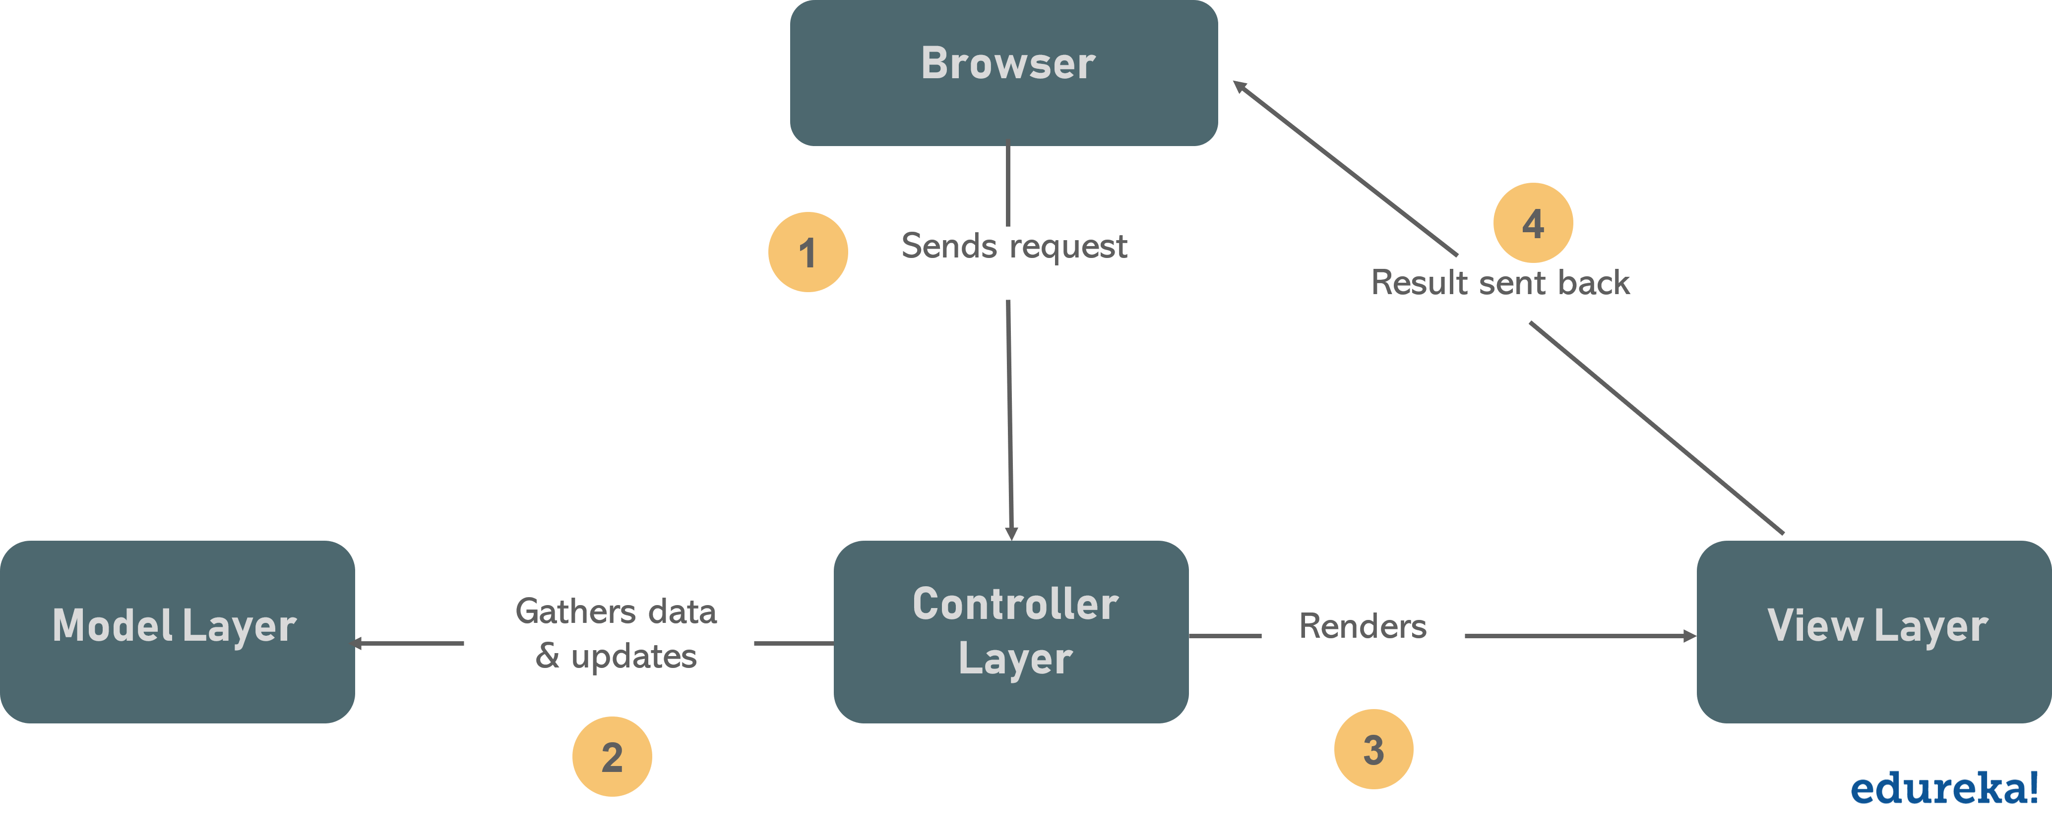

Slide 19
Blackboard pattern
This pattern is useful for problems for which no deterministic solution strategies are known.
  blackboard — a structured global memory containing objects from the solution space
  knowledge source — specialized modules with their own representation
  control component — selects, configures and executes modules.
Usage
  Speech recognition
  Vehicle identification and tracking
Notes:
, to coordinate separate, disparate systems that need to work together or in sequence, continually cycling for updates and actions.

Slide 20
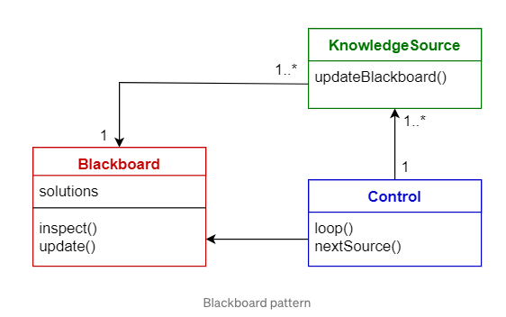
Notes:
, to coordinate separate, disparate systems that need to work together or in sequence, continually cycling for updates and actions.
The blackboard consists of a number of stores or "global variables". This is similar to a repository of messages, which can be accessed by separate autonomous processes. A "Controller" monitors the properties on the blackboard and can decide which "Knowledge Sources" to prioritize.
The challenge of making [potentially life and death] decisions in real time was two-fold:
1) Process the analogue radio data into digital patterns, as finely grained and quickly as possible
2) Analyse the pattern data to identify objects as fast and accurately as possible
Processing of radata

Slide 21
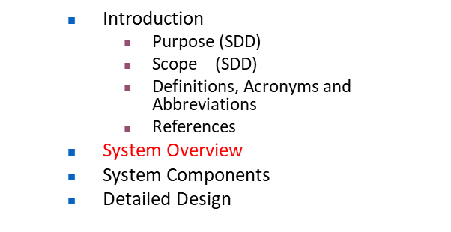




Accessing Internal Resources: one solution
More Examples for Software Architectures
Organization
Internet
AWS Lambda
Skill
Continuously poll inbound queue
1
Local PC inside organization
2
Alexa Service
1
5
Service
Inbound queue
Continuously poll outbound queue for data
AWS SQS
(Simple Queuing Service)
4
Get data from internal resources
Write data retrieved from internal resources to outbound queue
Outbound queue
3
LDAP
“Alexa, ask Office Locator where the office of Dr. John Smith is”
DB

Slide 22
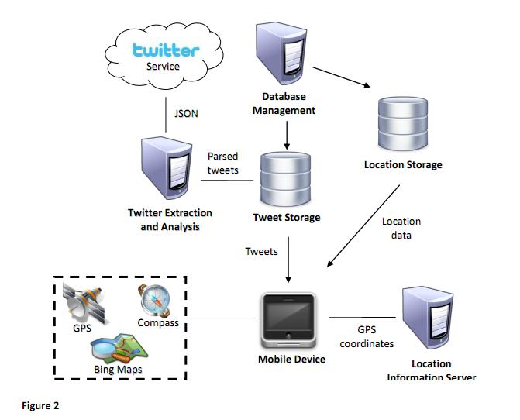
  Introduction
    Purpose (SDD)
    Scope (SDD)
    Definitions, Acronyms and Abbreviations
    References
  System Overview
  System Components
  Detailed Design

Slide 23
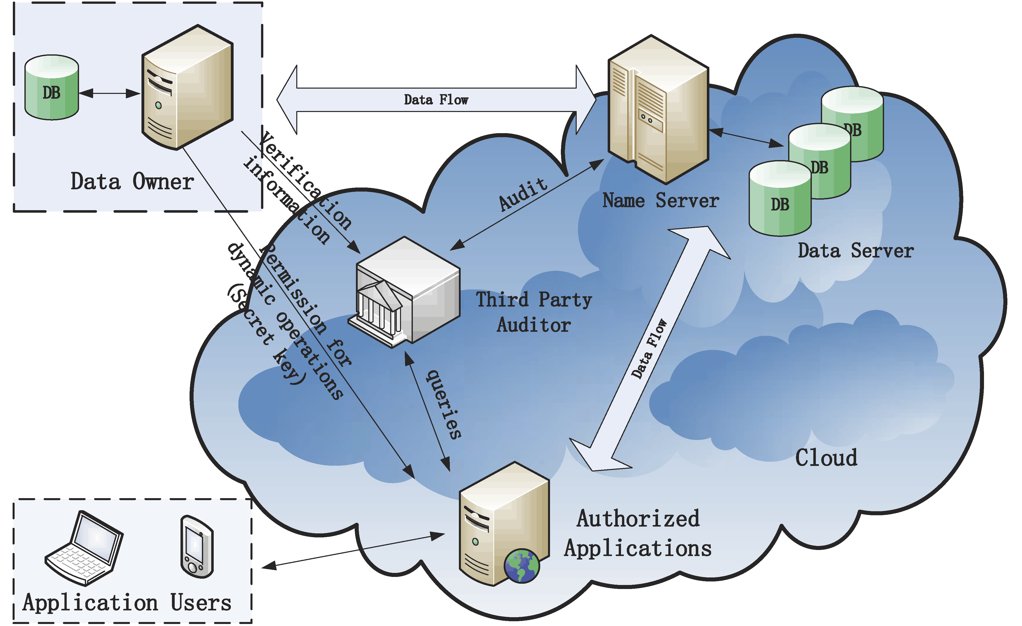

Slide 24
SDD
System Components
  Introduction
  System Overview
  System Components
    Decomposition Description
    Dependency Description
    Interface Description
      Module Interface
      User Interface (GUI)
  Detailed Design
Provide details for the components in the architectural design.
Supplement with text as needed.
You may choose to give a functional description or an object-oriented description.

Slide 25
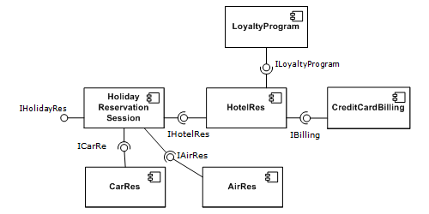
A simple example of several software components - pictured within a hypothetical holiday-reservation system

Slide 26
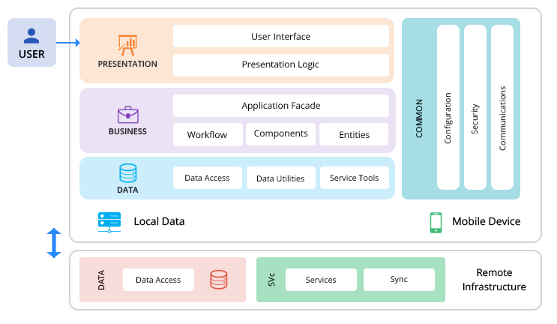

Slide 27
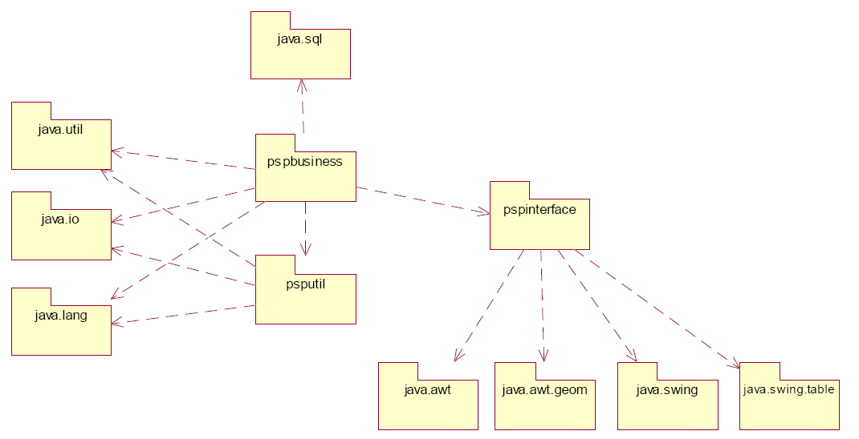
SDD
System Components
Dependency Description – Intermodule Description
  Introduction
  System Overview
  System Components
    Decomposition Description
    Dependency Description
    Interface Description
  Detailed Design
Example: Package Diagram (It might include classes in packges)

Slide 28
SDD
System Components
Interface Description
  Introduction
  System Overview
  System Components
    Decomposition Description
    Dependency Description
    Interface Description
      Module Interfaces
      User Interfaces (GUI)
  Detailed Design
Scope: Everything a designer, programmer or tester need to know to use the design entities of the system
The interface between a human and a computer is called a user interface.
Interfaces between hardware components are physical interfaces.
The software (module) interfaces exist between separate software components and provide a programmatic mechanism by which these components can communicate.

Slide 29
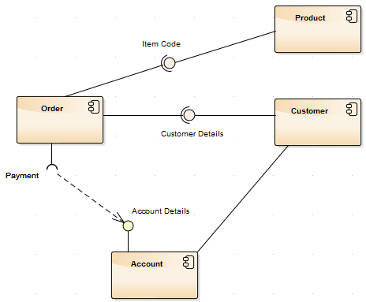
This symbol is usually used to represent a software interface

Slide 30
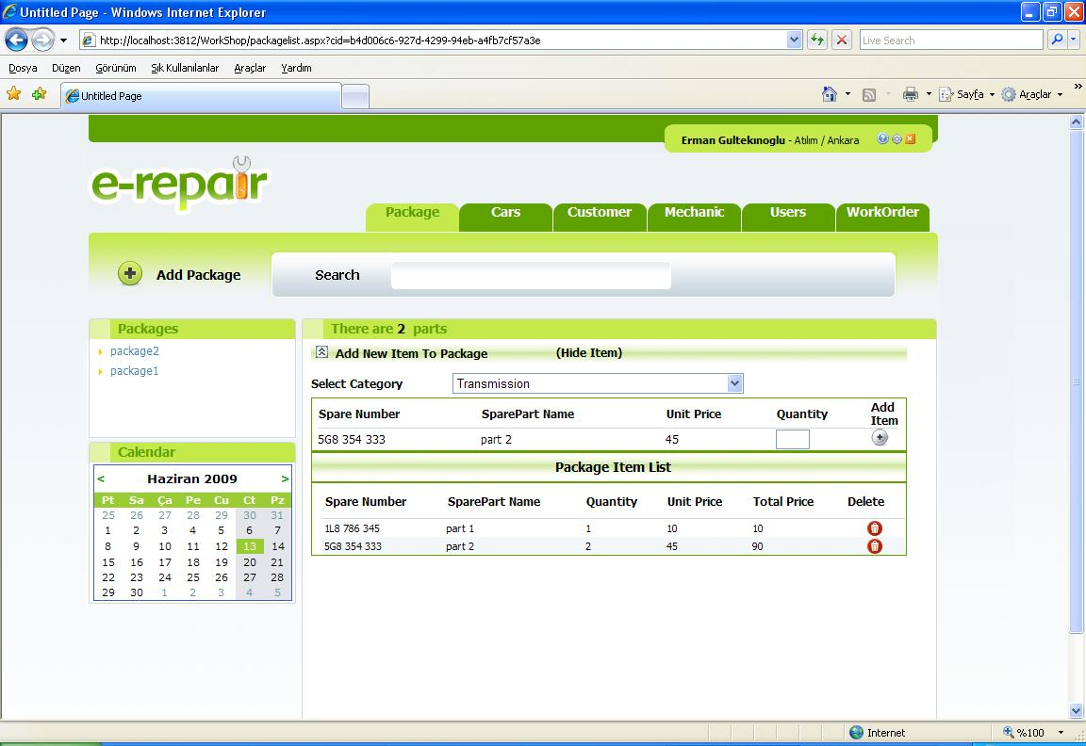
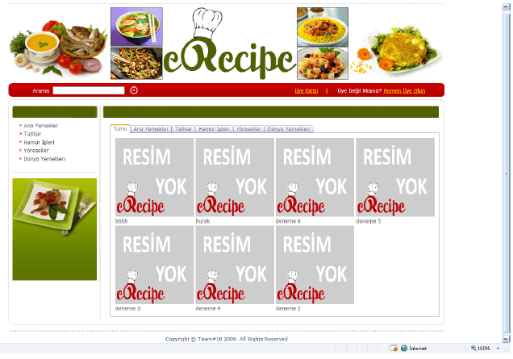
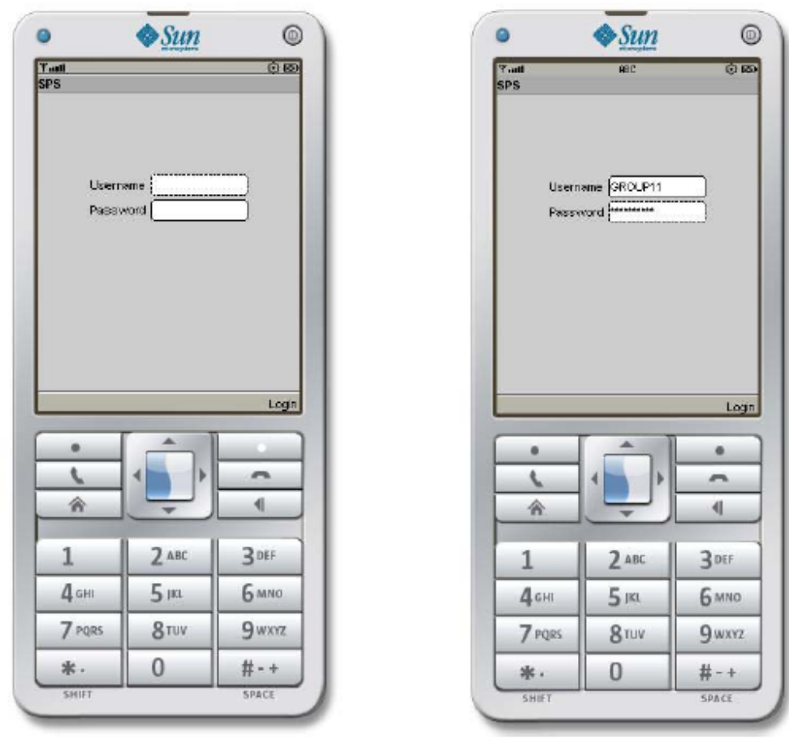
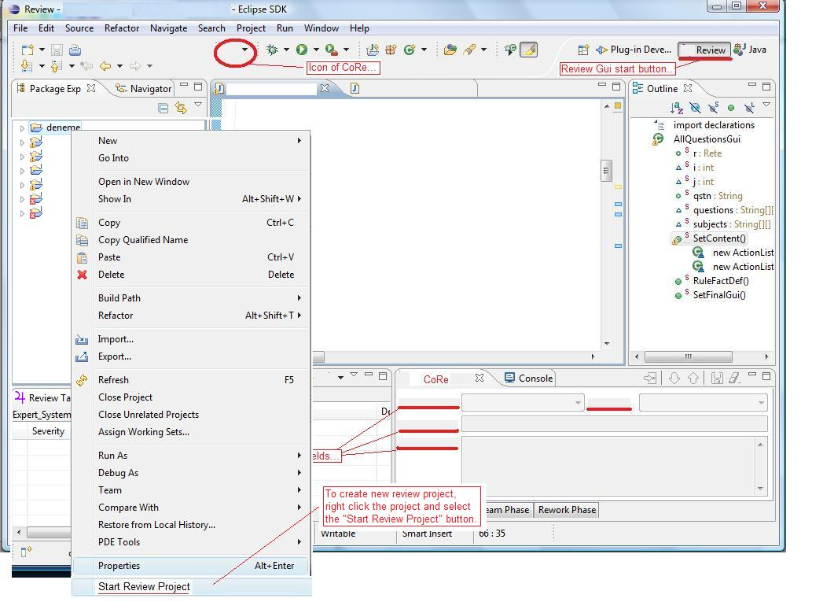
User Interface
User Interfaces (GUI)
  Describe the functionality of the system from the user’s perspective.
  Explain how the user will be able to use your system to complete all the expected features and the feedback information that will be displayed for the user.
  Provide layouts of main screens in accordance to a detailed sequence of operation (use cases).
  Provide interface design rules, such as:
    Are windows resizable or iconizable ?
    What is the policy regarding the presentation of error or log messages ?
    ...
FCS - AAO

Slide 31
SDD
Detailed Design
  Introduction
  System Overview
  System Components
  Detailed Design
    Module Detailed Design
    Data Detail edDesign
    RTM
  Example representations and methods:
    Classes
    Activity diagrams (control flow of actions)
    Sequence diagrams (interaction between objects in a sequential order)
    Pseudocode
    Tabular forms
  Also summarizes the relation with SRS

Slide 32
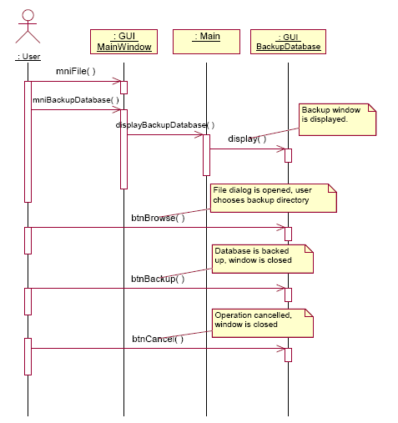
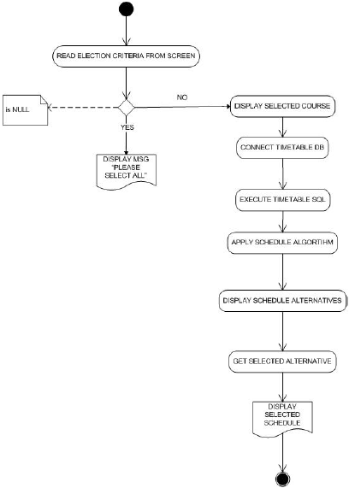
SDD
Detailed Design
Module Detailed Design
  Introduction
  System Overview
  System Components
  Detailed Design
    Module DetailedDesign
    Data Detailed Design
    RTM
Sequence Diagram
Activity Diagram
FCS - AAO

Slide 33
SDD
Detailed Design
Module Detailed Design
  Introduction
  System Overview
  System Components
  Detailed Design
    Module DetailedDesign
    Data Detailed Design
    RTM
FOR number of microseconds supplied by operator
    IF number of microseconds exceeds critical value
      Try to get supervisor's approval
      IF no supervisor's approval
        abort with "no supervisor approval for unusual duration" message
      ENDIF
    ENDIF
Pseudocode
FCS - AAO

Slide 34
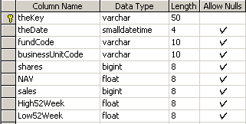

SDD
Detailed Design
Data Detailed Design
  Introduction
  System Overview
  System Components
  Detailed Design
    Module DetailedDesign
    Data Detailed Design
    RTM
Describe how the major data or system entities are stored, processed and organized.
List any databases or data storage items.
Table: tblSalesAndAssets
View: vRptByBusinessUnit
FCS - AAO

Slide 35
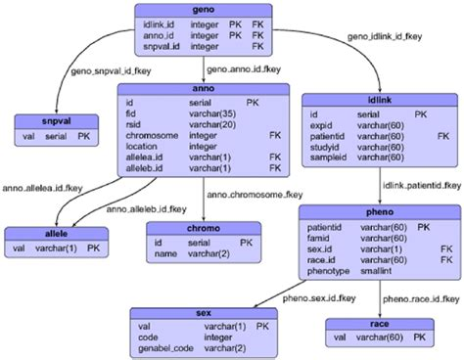

Slide 36
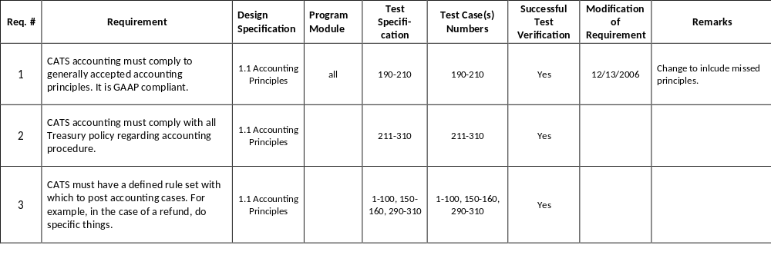
SDD
Detailed Design
Requirements Traceability Matrix (RTM)
  Introduction
  System Overview
  System Components
  Detailed Design
    Module DetailedDesign
    Data Detailed Design
    RTM
Provide a cross-reference that traces components and data structures to the requirements in your SRS document (later in STD and codes).
Use a tabular format to show which system components satisfy each of the functional requirements from the SRS.
Refer to the functional requirements by the numbers/codes that you gave them in the SRS.
FCS - AAO

